Slide 1
ADAPTIVE CLASSROOM ENERGY MANAGEMENT
MINI PROJECT
TEAM GUIDE
Dr. CHITHIRA P R
Assistant professor,Dept of ECE
TEAM 10
ATHUL KRISHNA K H PKD23EC022
FATHIMATHU SAJA K C PKD23EC029
SALMAN FARIZ T M PKD23EC058
SHIFANATH T S PKD23EC061

Slide 2
CONTENT
INTRODUCTION
PROBLEM STATEMENT
AIM
OBJECTIVES
LITERATURE SURVEY
COMPONENTS
SYSTEM DESIGN
BLOCKDIAGRAM
FLOWCHART
CIRCUITDIAGRAM
SIMULATION
1
2
2
3
4
6
9
18
19
20
21

Slide 3
PRACTICAL IMPLEMENTATION
CONTROL LOGIC
WORKING/METHODOLOGY
TECHNICAL PARAMETERS AND SPECIFICATIONS
GANTT CHART
WORK DISTRIBUTION
COST ESTIMATION
FUTURESCOPE
HARDWARE
CONCLUSION
CODE
THANK YOU
22
24
25
26
27
28
31
32
33
34
35
43

Slide 4
INTRODUCTION
1
• Classroom appliances like fans, lights are manually controlled, causing energy
wastage
• An automated system using PIR, temperature, and light sensors can intelligently
control appliances by detecting student presence,ambient temperature,and
natural light availability, ensuring efficient energy usage

Slide 5
PROBLEM STATEMENT
2
Manual control of classroom lights and fans without considering occupancy, light intensity, and temperature causes unnecessary energy wastage. An automated system is required to control appliances efficiently based on room occupancy and environmental conditions
AIM
To design an automatic classroom energy management system that controls lights and fans based on occupancy, ambient light, and temperature to reduce energy wastage

Slide 6
OBJECTIVES
3
To automatically control lights and fans based on real-time environmental conditions.
To sense classroom conditions such as light intensity, temperature, and occupancy, the system sends signals to the microcontroller, which automatically switches the lights and fan ON or OFF to reduce unnecessary power consumption and maintain basic comfort
To demonstrate a simple system where a single LED light (9– 12 W) and a fan (35–60 W) connected through an extension board which operate automatically only when needed.
To display classroom conditions such as temperature (in Celsius), light intensity, motion detection, and the status of the fan and lights (ON/OFF), an OLED display is used.
To provide two manual switch option for controlling the fan and lights when required.

Slide 7
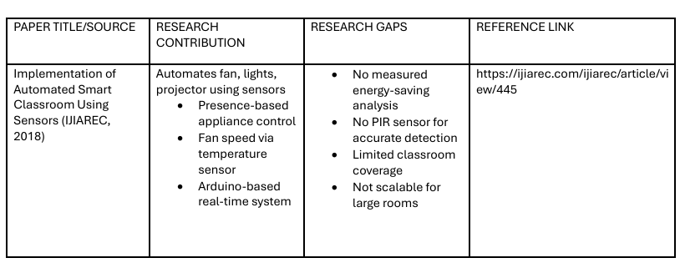
LITERATURE SURVEY
4

Slide 8
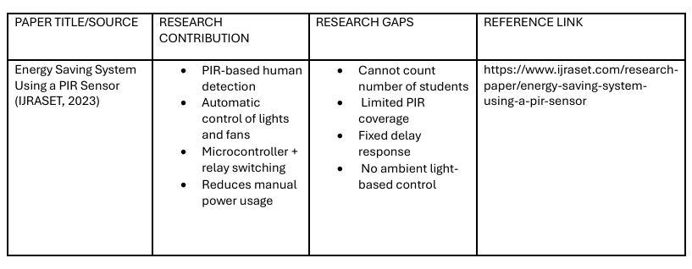
5

Slide 9
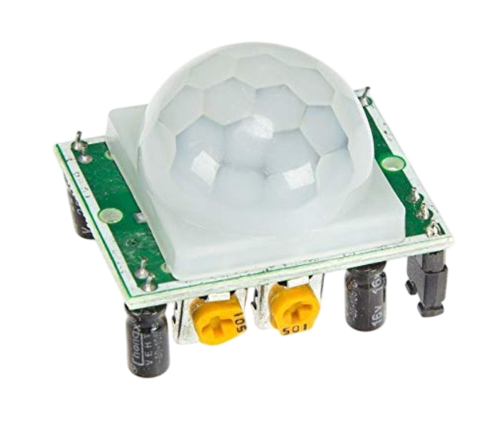
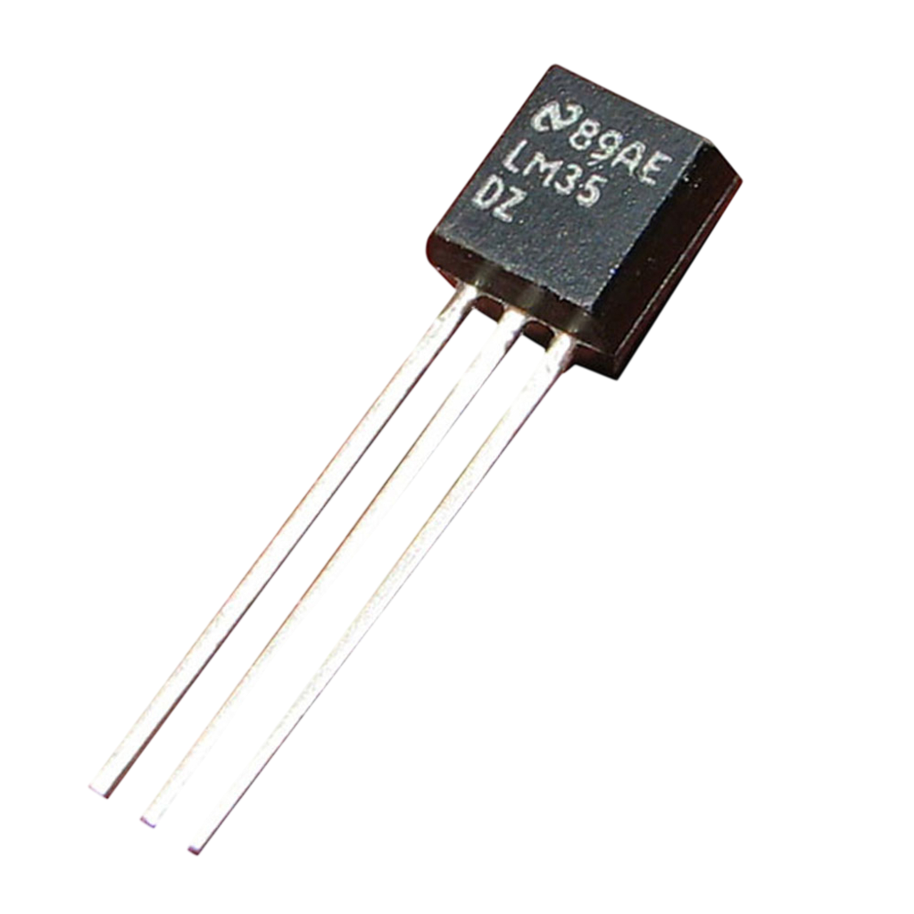
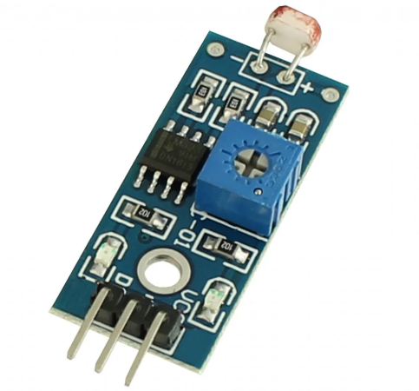
COMPONENTS
6
1.PIR SENSOR (HC SR-501)
The PIR sensor detects human motion or occupancy in a room. It operates at 5–12V and outputs a HIGH signal when motion is detected
2.TEMPERATURE SENSOR (LM 35)
The LM35 is a precision temperature sensor that operates at 4–30V and can be used for temperature monitoring
3.LDR MODULE (GL 5528)
The LDR module detects ambient light intensity using an LM393 comparator for adjustable sensitivity. It provides digital and analog outputs, enabling automation of devices like streetlights based on brightness levels.

Slide 10
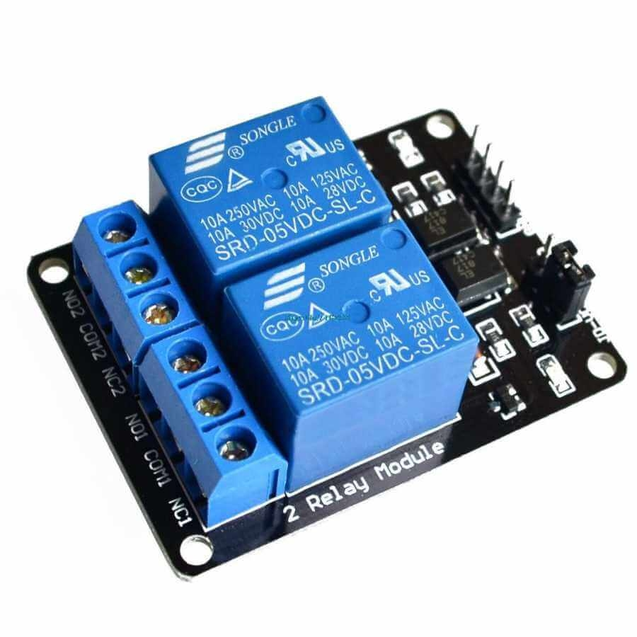
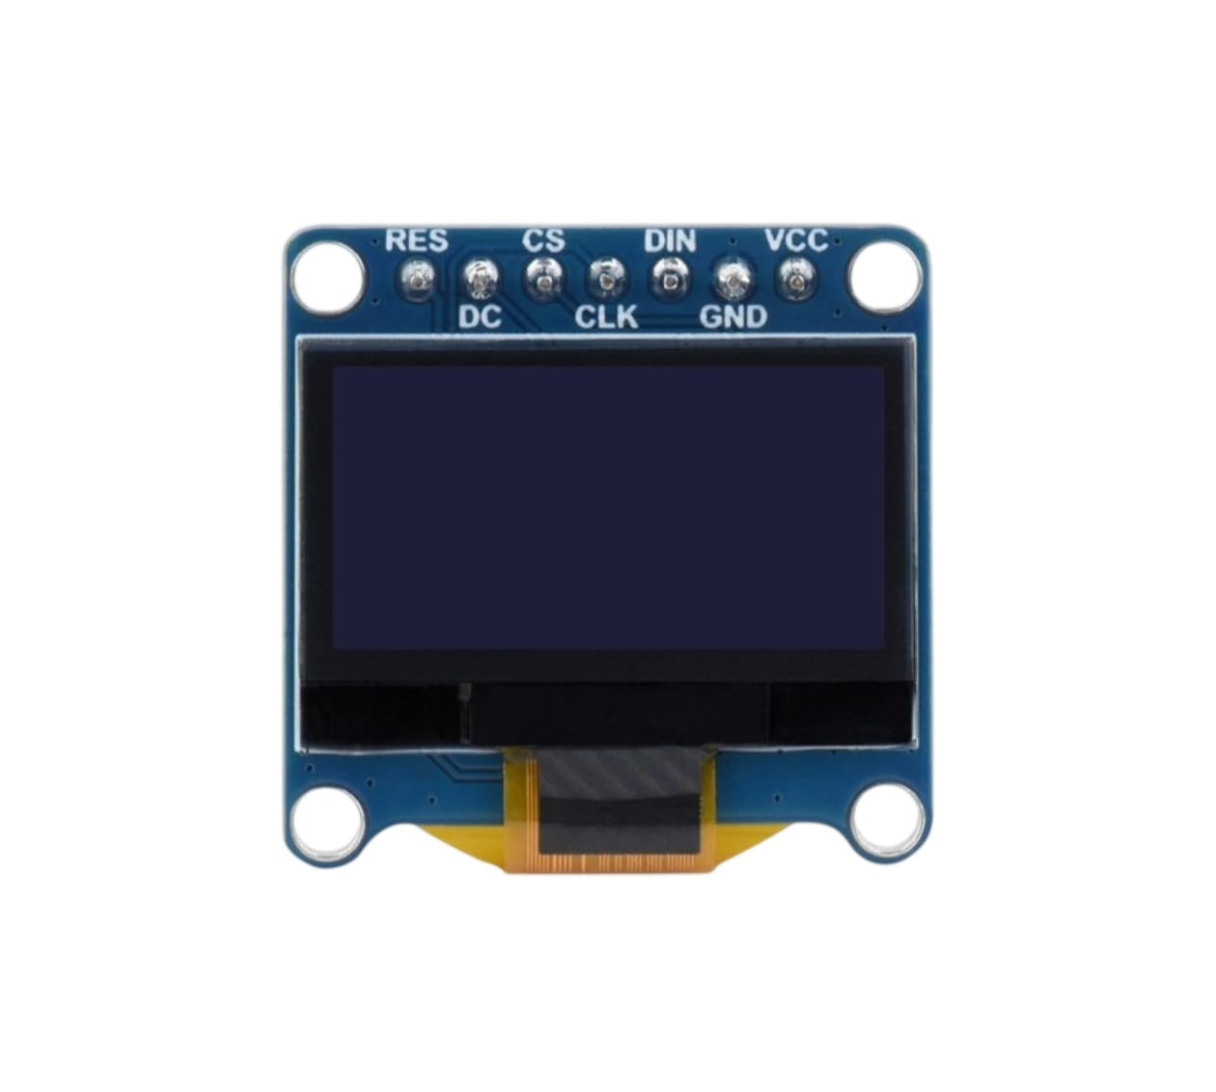
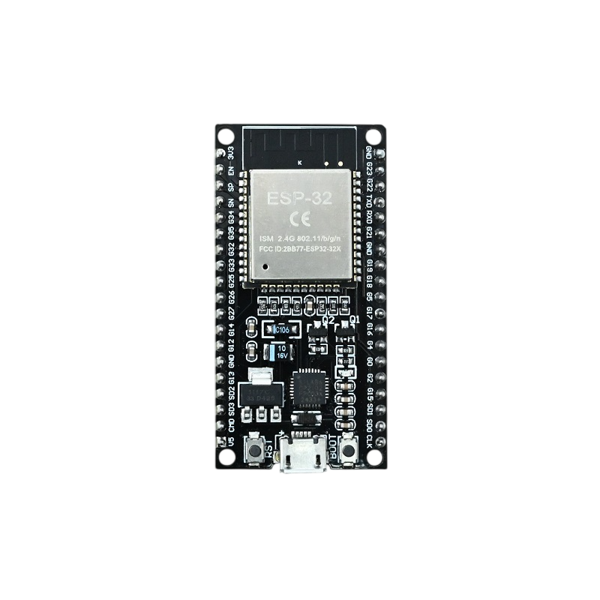
7
4.RELAY MODULE
A relay module is an electrically operated switch that allows low-voltage signals to control high-voltage devices. It works with a 5V control signal and is used to safely turn on or off devices like fans and lights.
5.OLED DISPLAY
The OLED display is a low-power module with a resolution of 128×64 pixels. It operates at 3.3–5V and communicates using the I2C protocol. It is commonly used to show sensor readings and system status
6.ESP32D MICROCONTROLLER
The ESP32 is a powerful microcontroller with built-in Wi-Fi and Bluetooth for IoT applications. It operates at 3.0–3.6V and features a 240 MHz dual-core processor. It is widely used for control, monitoring, and communication in smart systems.

Slide 11
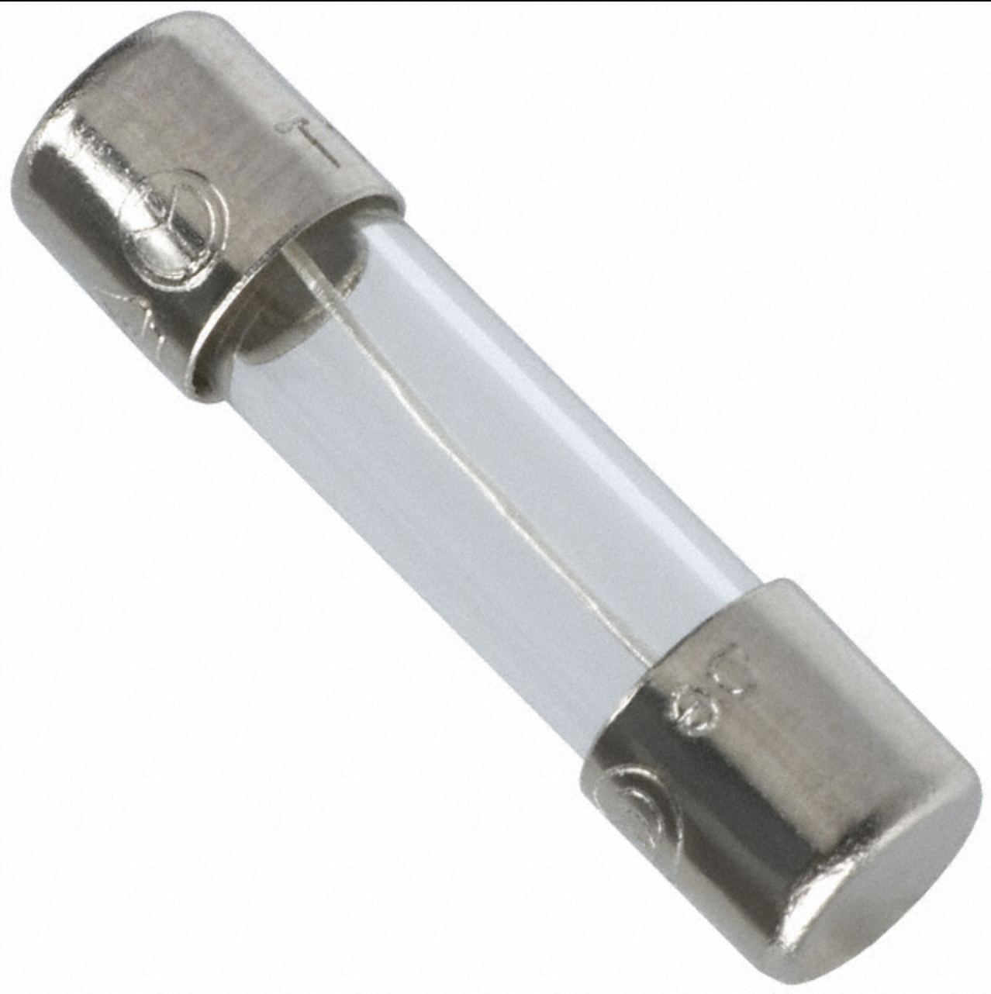
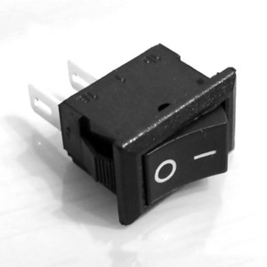
8
A 5A fuse is a protective device that safeguards circuits against overcurrent by breaking the circuit if the current exceeds 5 amperes. It ensures the safety of connected components and prevents potential damage or hazards.
A switch is a manual device used to open or close a circuit, allowing control of electrical devices like lights and fans. It provides a simple way to turn the system ON or OFF safely.
7.5 A Fuse
8.Switch

Slide 12
9
SYSTEM DESIGN
• The system consists of input sensors (PIR HC-SR501, LM35, and LDR GL5528) connected
to the ESP32 microcontroller
• Sensor data is processed by the ESP32, which makes control decisions based on classroom
conditions
• The relay module acts as an interface between the ESP32 and electrical appliances like
lights and fan
• An OLED display is used to show real-time parameters such as temperature,light intensity
(ADC value), motion status, and appliance status
• Two manual switch is provided to allow users to control the appliances when required

Slide 13
10
ESP32 Development Board
• Operating voltage = 3.3 V
• Used as the main controller
• Reads sensor data through GPIO and ADC pins
• Controls relay module and OLED display using digital signals and I2C communication
PIR Sensor (HC-SR501)
• Operating voltage = 5 V
• Output type = Digital
• Output condition:
• Motion detected → HIGH
• No motion → LOW
• Used to activate system operation based on human motion detection
• Detection distance: 3 to 7 meters
• Detection angle: ~110° to 140°

Slide 14
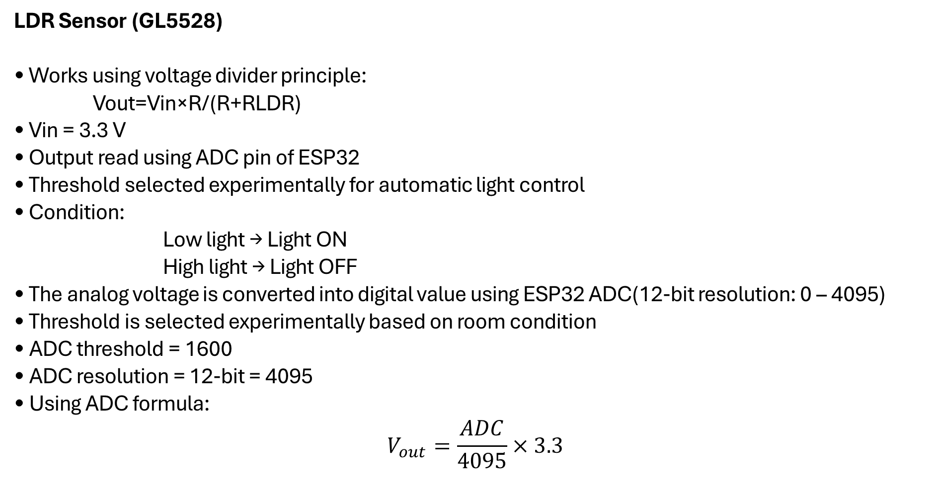
11
LDR Sensor (GL5528)
• Works using voltage divider principle:
Vout​=Vin​×R/(R+​R​LDR)
• Vin = 3.3 V
• Output read using ADC pin of ESP32
• Threshold selected experimentally for automatic light control
• Condition:
Low light → Light ON
High light → Light OFF
• The analog voltage is converted into digital value using ESP32 ADC(12-bit resolution: 0 – 4095)
• Threshold is selected experimentally based on room condition
• ADC threshold = 1600
• ADC resolution = 12-bit = 4095
• Using ADC formula:
$$V_{out}=\frac{ADC}{4095}×3.3$$

Slide 15
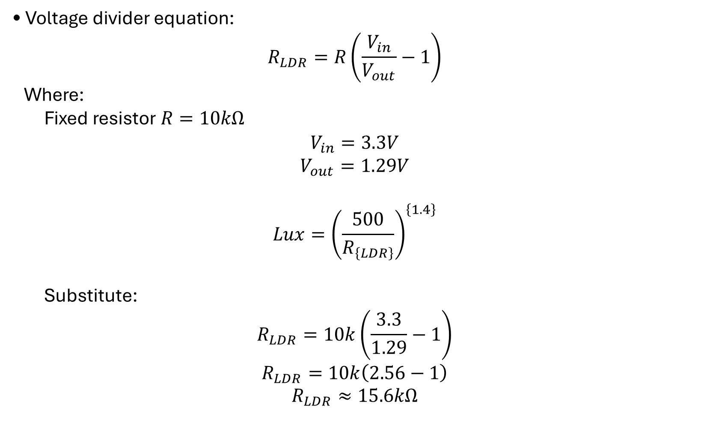
12
• Voltage divider equation:
$$R_{LDR}=R\left(\frac{V_{in}}{V_{out}}−1\right)$$
Where:
Fixed resistor $R=10kΩ$
$$V_{in}=3.3V$$
$$V_{out}=1.29V$$
$$Lux={\left(\frac{500}{R_{\left\{LDR\right\}}}\right)}^{\left\{1.4\right\}}$$
Substitute:
$$R_{LDR}=10k\left(\frac{3.3}{1.29}−1\right)$$
$$R_{LDR}=10k\left(2.56−1\right)$$
$$R_{LDR}≈15.6kΩ$$

Slide 16
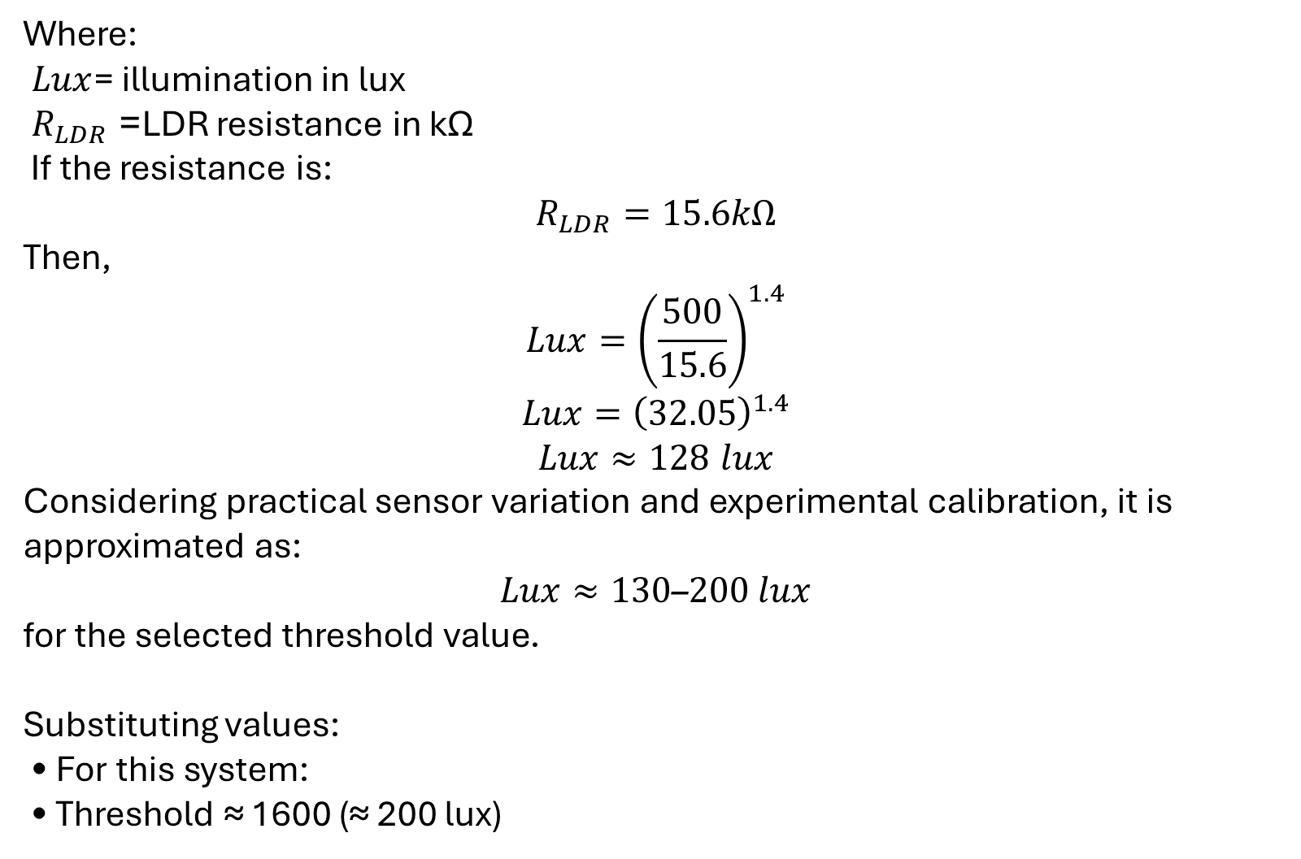
Where:
$Lux$= illumination in lux
${ R}_{LDR}$= LDR resistance in kΩ
If the resistance is:
$$R_{LDR}=15.6kΩ$$
Then,
$$Lux={\left(\frac{500}{15.6}\right)}^{1.4}$$
$$Lux={\left(32.05\right)}^{1.4}$$
$$Lux≈128 lux$$
Considering practical sensor variation and experimental calibration, it is approximated as:
$$Lux≈130\text{–}200 lux$$
for the selected threshold value.
Substituting values:
• For this system:
• Threshold ≈ 1600 (≈ 200 lux)
13

Slide 17
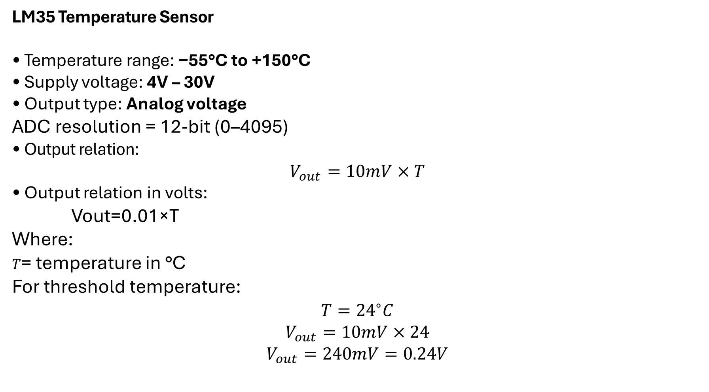
14
LM35 Temperature Sensor
• Temperature range: −55°C to +150°C
• Supply voltage: 4V – 30V
• Output type: Analog voltage
ADC resolution = 12-bit (0–4095)
• Output relation:
$$V_{out}=10mV×T$$
• Output relation in volts:
Vout​=0.01×T
Where:
$T$= temperature in °C
For threshold temperature:
$$T={24}^{∘}C$$
$$V_{out}=10mV×24$$
$$V_{out}=240mV=0.24V$$

Slide 18
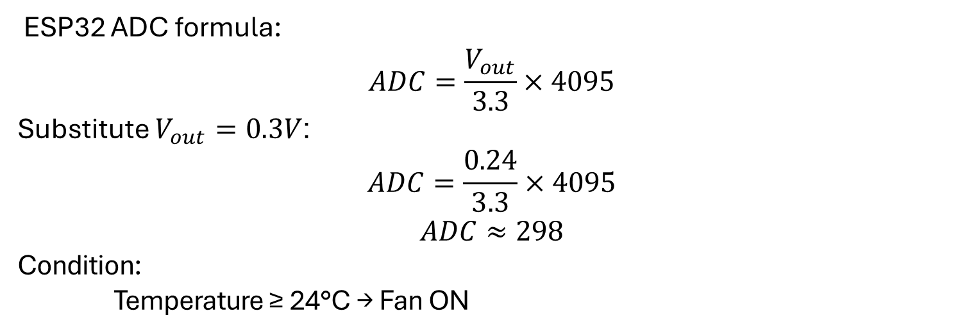
15
ESP32 ADC formula:
$$ADC=\frac{V_{out}}{3.3}×4095$$
Substitute $V_{out}=0.3V$:
$$ADC=\frac{0.24}{3.3}×4095$$
$$ADC≈298$$
Condition:
Temperature ≥ 24°C → Fan ON
Fan
• Supply voltage = 230V AC
• Power rating ≈ 60 W
• Controlled automatically using relay based on temperature and motion detection

Slide 19
16
Light
• Supply voltage = 230V AC
• Power rating ≈ 9 W LED bulb
• Controlled automatically based on motion detection and light intensity
Relay Module (5V)
Used to control 230V AC appliances
• Load calculation:
Fan power ≈ 60 W
I=V/P​=60​/230≈0.26 A
Light power ≈ 9 W
I = V/P=9/230= 0.04A
• Total current:
0.26 + 0.04 = 0.30A
• Relay rating:
5A / 230V AC

Slide 20
17
Fuse (5A)
Fuse selection rule:
Fuse\ rating ≈ 2 × Load\ current
Load current ≈ 0.30A
Selected fuse = 5A
Provides safety against overcurrent and short circuit
Switch
• Used for manual control and safety isolation
• Allows user to operate system manually if required
OLED Display
• Operating voltage = 3.3V–5V
• Communication protocol = I2C
• Pins used:
SDA
SCL
• Displays system status like motion detection and temperature value

Slide 21
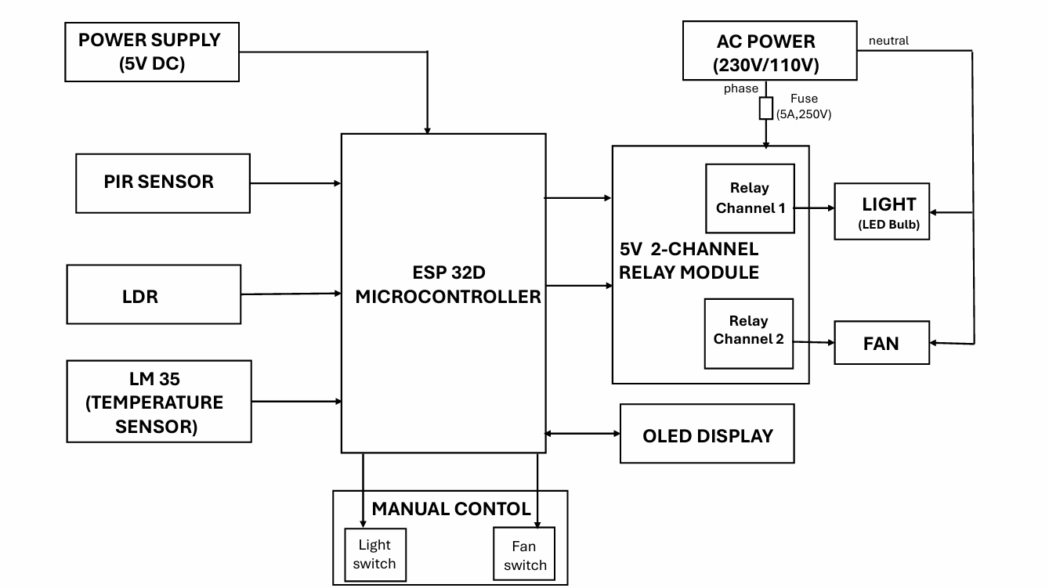
BLOCK DIAGRAM
18

Slide 22
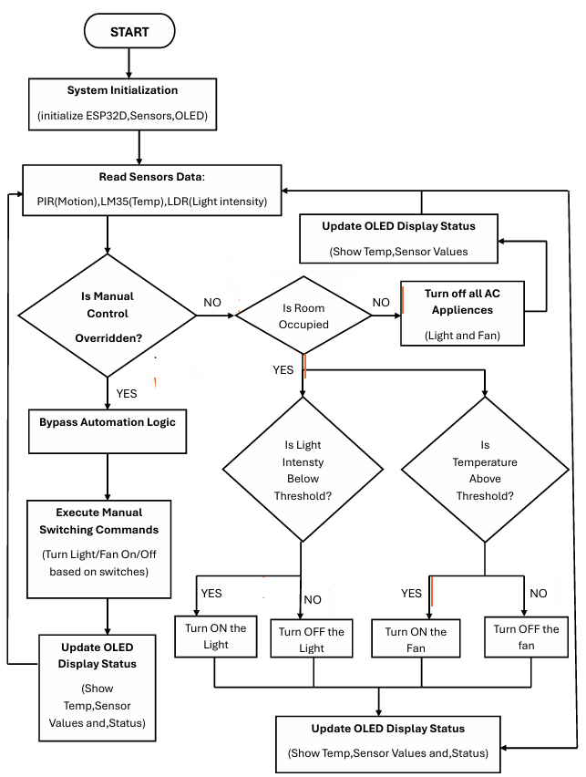
FLOWCHART
19

Slide 23
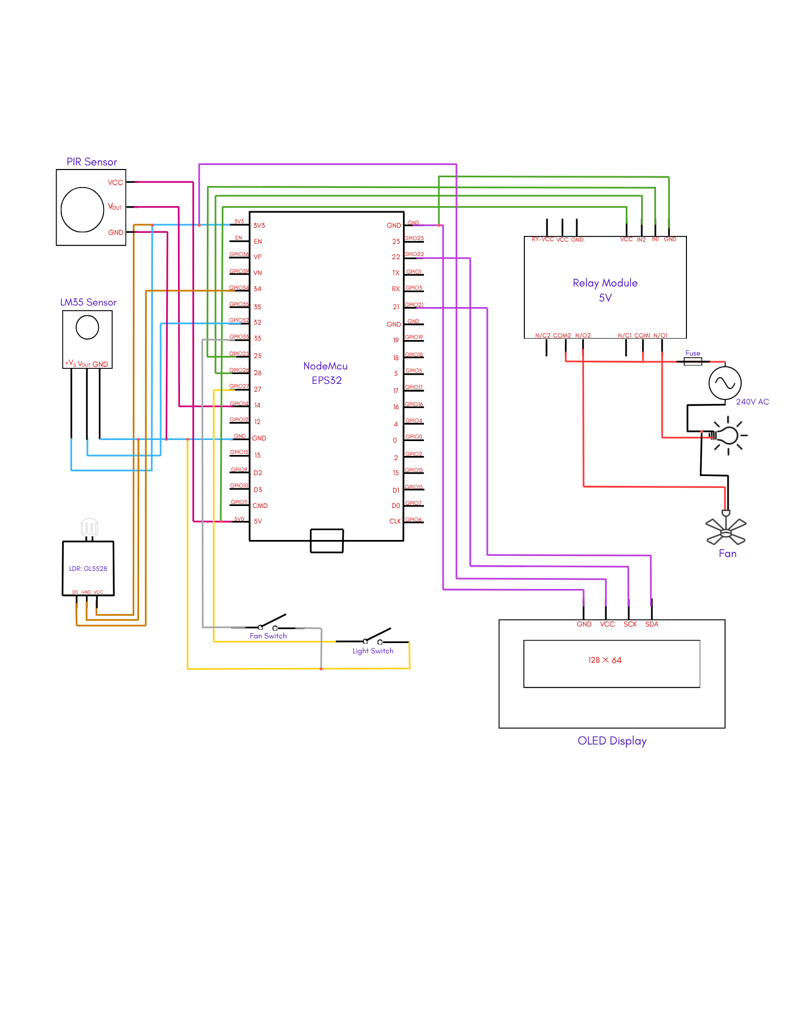
CIRCUIT DIAGRAM
20

Slide 24
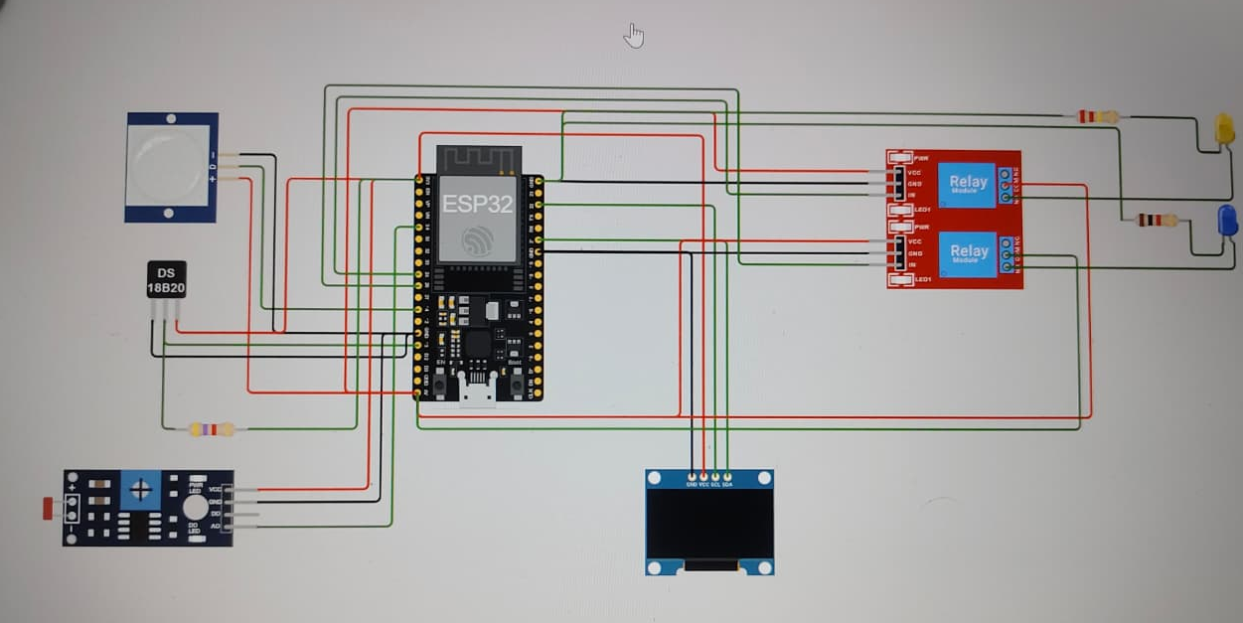
SIMULATION
21
:-fig: SIMULATION IN WOKWI

Slide 25
PRACTICAL IMPLEMENTATION
22
The system is implemented as a prototype model using ESP32 microcontroller as the main controller.
The PIR sensor (HC-SR501) is connected to detect classroom occupancy (motion).
The LM35 temperature sensor is interfaced with ESP32 to measure room temperature.
The LDR (GL5528) is used to sense classroom light intensity in ADC-converted mode.
An OLED display is connected to show temperature, light intensity, motion status, and appliance ON/OFF status.

Slide 26
23
A relay module interfaces the ESP32 with AC appliances such as a fan and light for demonstration
An AC power supply with fuse protection is used to ensure safe and reliable operation.
Manual switches are provided for user control during testing and operation.
All components are assembled using a breadboard prototype setup for practical demonstration.

Slide 27
CONTROL LOGIC
24
HC-SR501 PIR SENSOR
• Detect occupancy based on infrared rays
LM35 TEMPERSENSORATURE
• No Occupancy: Fans OFF
• Occupancy Detected & Temperature < 24 °C: Fans OFF
• Occupancy Detected & Temperature => 24 °C: Fans ON
LDR GL5528 SENSOR
• No occupancy : Lights OFF
• Occupancy detected + sufficient daylight(<1600) : Lights OFF
• Occupancy detected + low light(>=1600): Lights ON

Slide 28
WORKING / METHODOLOGY
25
PIR Sensor: Detects classroom occupancy via infrared; sends signal to ESP32.
Temperature Control (LM35): Fan ON if occupancy detected and temperature
≥ 24 °C; otherwise OFF.
Light Control (LDR GL5528): Lights ON if occupancy detected and ambient light is low; otherwise OFF.
ESP32 Controller: Processes sensor data and switches fan and lights through relays
Display & Monitoring: OLED shows occupancy, temperature, and light status.
Safety & Manual Control: 5A fuse protects circuit; manual switch allows override.

Slide 29
TECHNICAL PARAMETERS AND SPECIFICATIONS
26
Component | Specification
Microcontroller(ESP32D) | 3.3 V logic, input supply 5 V via regulator/USB
Light Sensor (LDR GL-5528) | Operating voltage: 3.3–5 V, Current: ~0.1–1 mA
OLED Display | 3.3 V DC, Current: 10–30 mA
PIR Sensor (HC-SR501) | Supply: 5 V DC, Current: ~50–65 µA , up to ~10 mA active
Temperature Sensor(LM35) | Supply: 4–30 V DC, Range: 0°C to 100°C, Accuracy: ±0.5°C, Output: 10 mV/°C
Relay Module | Coil: 5 V DC, Contact rating: 250 V AC / 10 A
Fan Load | 230 V AC, Power: 35–60 W, Current: 0.15–0.26 A
Light | 230 V AC, Power: 9–12 W, Current: 0.04–0.06 A
Power Supply | Input: 230 V AC, Output: 5 V DC (regulated)

Slide 30
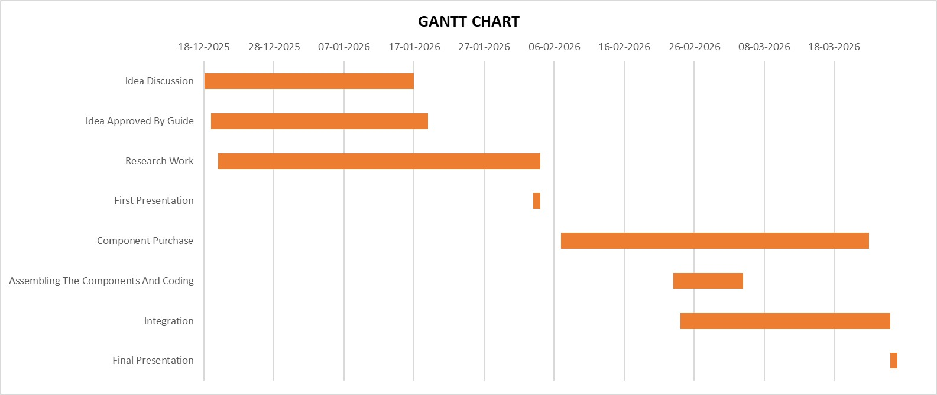
GANTT CHART
27

Slide 31
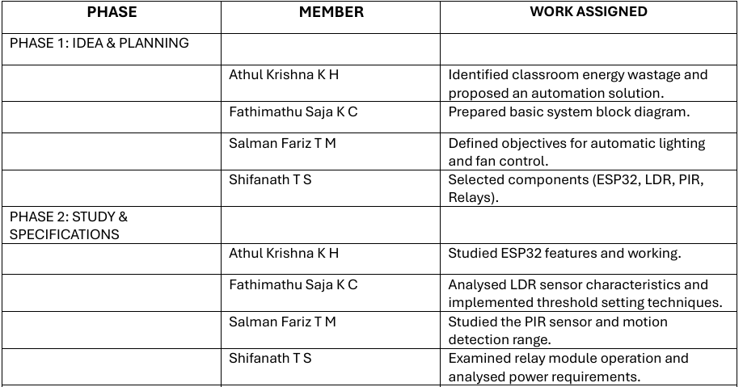
WORK DISTRIBUTION
28

Slide 32
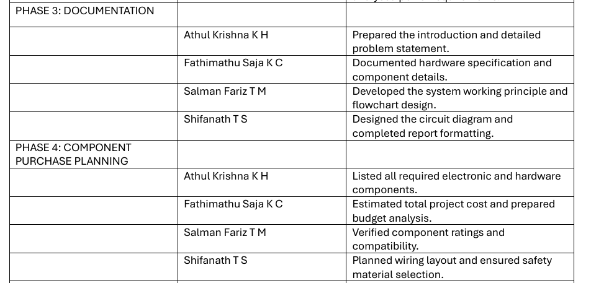
29

Slide 33
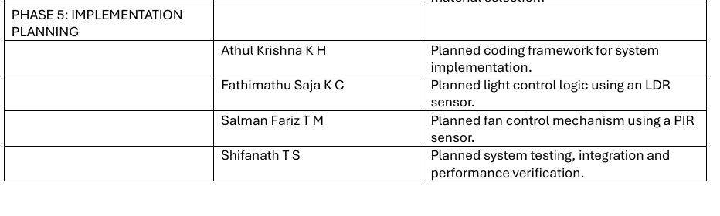
30

Slide 34
COST ESTIMATION
31
SI.NO | COMPONENTS | COST | SI.NO | COMPONENTS | COST
1 | ESP32D | 381 | 11 | JUMPER WIRES(3 SET) | 45
2 | PIR SENSOR | 60 | 12 | DATA CABLE | 150
3 | TEMPERATURE SENSOR | 40 | 13 | BREADBOARD | 130
4 | LDR SENSOR | 60 | 14 | 5 A FUSE | 30
5 | TWO CHANNEL 5V RELAY MODULE | 80 | 15 | THREE PIN PLUG | 100
6 | OLED DISPLAY | 280 | 16 | SOCKET PLUG | 60
7 | HLK-LD2410 | 590 | 17 | SWITCH BOARD | 150
8 | LIGHT | 120 | 18 | CONNECTING WIRES | 60
9 | FAN | 2100 | 19 | SWITCHES | 40
10 | EXTENSION BOARD | 250
TOTAL COST: 4726/-

Slide 35
RESULT
32
The Smart Classroom Energy Management System was successfully implemented using ESP32 with PIR sensor, LM35 temperature sensor, and LDR sensor
The PIR sensor detected human motion and was used to determine classroom occupancy status.
The LM35 sensor monitored temperature and automatically switched the fan ON when temperature ≥ 22 °C during motion detection.
The LDR sensor controlled the lights based on surrounding light conditions.
The relay module successfully operated the AC fan and light according to sensor inputs.
The OLED display showed real-time status of motion detection, temperature, and appliance operation
The system helped reduce unnecessary power consumption when the classroom was empty.

Slide 36
33
FUTURESCOPE
• Integration of IoT for remote monitoring and control
• Mobile app or web-based classroom management
• Suitable for smart classroom and smart campus systems
• Use of AI and machine learning for intelligent automation
• Automatic optimization based on usage patterns
• Improved energy efficiency using smart decision making
• Addition of humidity, air quality, and CO₂ sensors
• Enhanced classroom comfort and environmental monitoring
• Expansion to control projectors, ACs, and ventilation systems
• Cloud-based data storage and energy analysis
• Power usage monitoring for better management
• Use of solid-state relays for faster and reliable switching
• Improved scalability and system performance

Slide 37
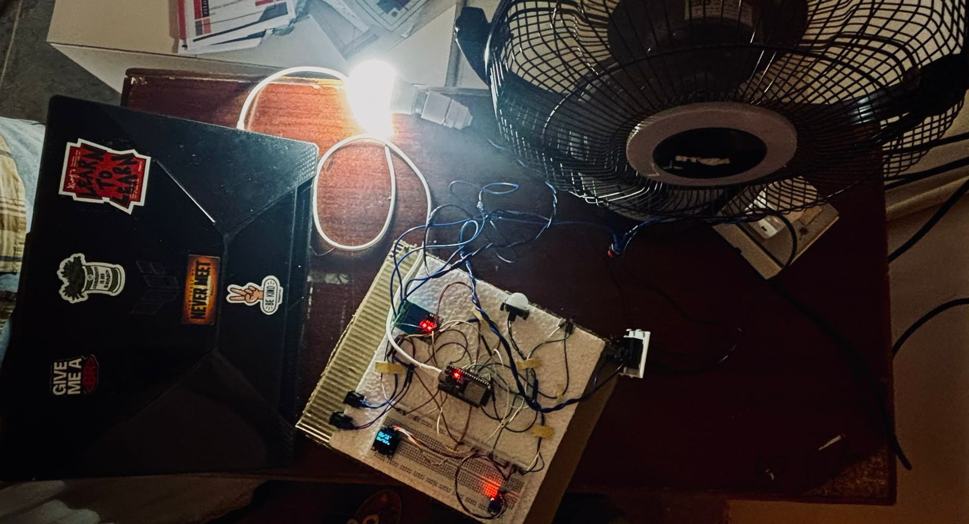
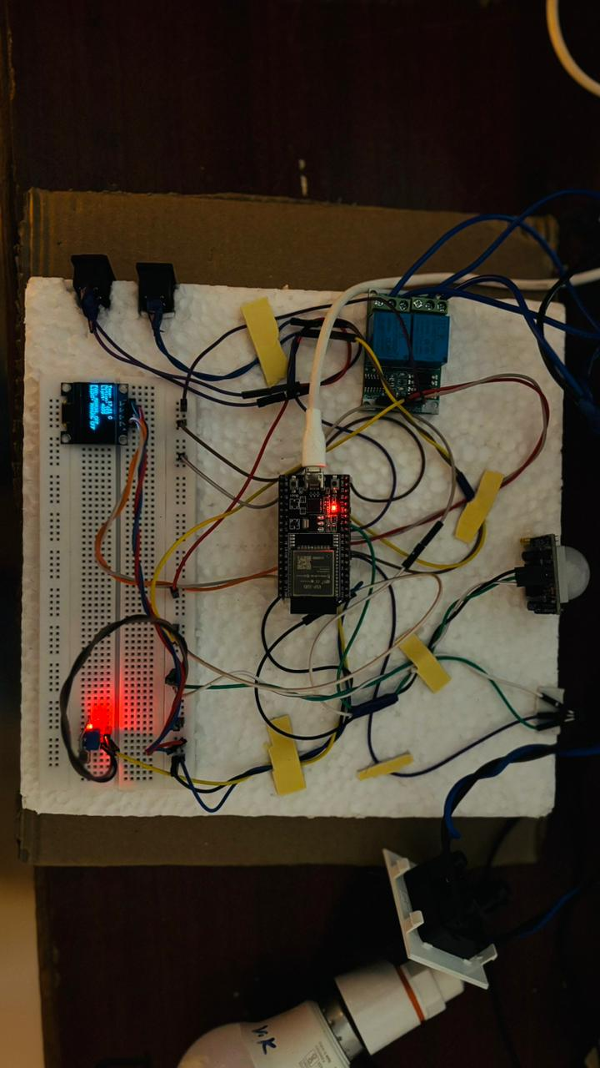
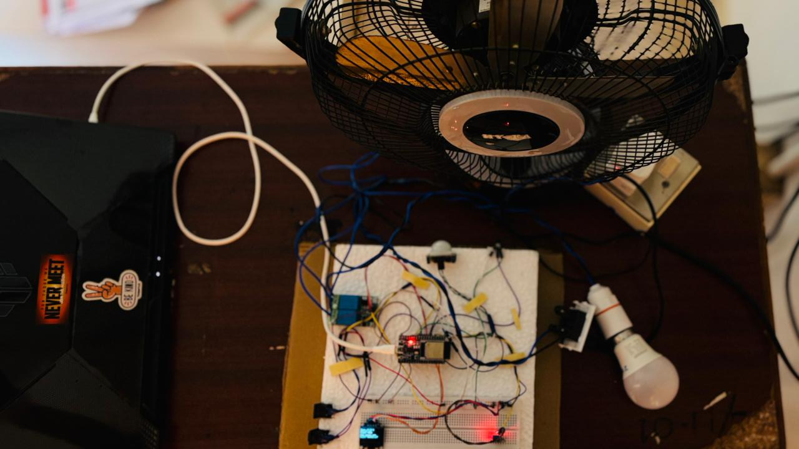
HARDWARE
34

Slide 38
CONCLUSION
35
The Smart Classroom Energy Management System successfully demonstrated automatic control of classroom lights and fan based on occupancy,temperature, and ambient light conditions using the ESP32, thereby improving energy efficiency and reducing unnecessary power consumption.

Slide 39
CODE
36
#include <Wire.h>
#include <Adafruit_GFX.h>
#include <Adafruit_SSD1306.h>
// -------- PIN DEFINITIONS --------
#define PIR_PIN 14
#define LDR_PIN 34
#define LM35_PIN 32
#define RELAY_FAN 26
#define RELAY_LIGHT 25
#define FAN_SWITCH 33
#define LIGHT_SWITCH 27
// -------- OLED --------
#define SCREEN_WIDTH 128
#define SCREEN_HEIGHT 64
Adafruit_SSD1306 display(SCREEN_WIDTH, SCREEN_HEIGHT, &Wire, -1);

Slide 40
37
// -------- TIMING --------
unsigned long lastUpdate = 0;
const int interval = 200;
// -------- MOTION FILTER --------
bool motionState = false;
unsigned long lastMotionTime = 0;
unsigned long lastHighTime = 0;
const unsigned long motionHoldTime = 5000;
const unsigned long lowConfirmTime = 500;
// -------- MODES --------
int fanMode = 0; // 0=AUTO, 1=ON, 2=OFF
int lightMode = 0; // 0=AUTO, 1=ON, 2=OFF
bool lastFanSwitch = HIGH;
bool lastLightSwitch = HIGH;

Slide 41
38
// -------- SETUP --------
void setup() {
Serial.begin(115200);
pinMode(PIR_PIN, INPUT);
pinMode(LDR_PIN, INPUT);
pinMode(LM35_PIN, INPUT);
pinMode(RELAY_FAN, OUTPUT);
pinMode(RELAY_LIGHT, OUTPUT);
pinMode(FAN_SWITCH, INPUT_PULLUP);
pinMode(LIGHT_SWITCH, INPUT_PULLUP);
digitalWrite(RELAY_FAN, HIGH);
digitalWrite(RELAY_LIGHT, HIGH);
delay(3000);
Wire.begin(21, 22);
if (!display.begin(SSD1306_SWITCHCAPVCC, 0x3C)) {
while (true);
}
display.clearDisplay();
display.setTextSize(1);
display.setTextColor(WHITE);
}
// -------- LOOP --------
void loop() {
if (millis() - lastUpdate >= interval) {
lastUpdate = millis();

Slide 42
39
// -------- SWITCH HANDLING --------
bool fanSw = digitalRead(FAN_SWITCH);
bool lightSw = digitalRead(LIGHT_SWITCH);
if (lastFanSwitch == HIGH && fanSw == LOW) {
fanMode++;
if (fanMode > 2) fanMode = 0;
delay(200);
}
if (lastLightSwitch == HIGH && lightSw == LOW) {
lightMode++;
if (lightMode > 2) lightMode = 0;
delay(200);
}
lastFanSwitch = fanSw;
lastLightSwitch = lightSw;
int rawMotion = digitalRead(PIR_PIN);
// -------- MOTION FILTER --------
if (rawMotion == HIGH) {
lastMotionTime = millis();
lastHighTime = millis();
}

Slide 43
if (rawMotion == LOW) {
if (millis() - lastHighTime > lowConfirmTime) {
if (millis() - lastMotionTime > motionHoldTime) {
motionState = false;
}
}
}
if (millis() - lastMotionTime <= motionHoldTime) {
motionState = true;
}
int lightValue = analogRead(LDR_PIN);
int adcValue = analogRead(LM35_PIN);
float voltage = adcValue * (3.3 / 4095.0);
float temp = voltage * 100.0;
// -------- FAN CONTROL --------
if (fanMode == 1) {
digitalWrite(RELAY_FAN, LOW); // ON
}
else if (fanMode == 2) {
digitalWrite(RELAY_FAN, HIGH); // OFF
}
else {
if (motionState && temp > 24) {
digitalWrite(RELAY_FAN, LOW);
} else {
digitalWrite(RELAY_FAN, HIGH);
}
}
40

Slide 44
// -------- LIGHT CONTROL --------
if (lightMode == 1) {
digitalWrite(RELAY_LIGHT, LOW); // ON
}
else if (lightMode == 2) {
digitalWrite(RELAY_LIGHT, HIGH); // OFF
}
else {
if (motionState && lightValue >= 2000) {
digitalWrite(RELAY_LIGHT, LOW);
} else {
digitalWrite(RELAY_LIGHT, HIGH);
}
}
// -------- OLED --------
display.clearDisplay();
display.setCursor(0, 0);
display.print("Temp: ");
display.print(temp);
display.println(" C");
display.print("Motion: ");
display.println(motionState ? "YES" : "NO");
display.print("Light: ");
display.println(lightValue);
display.println("");
41

Slide 45
42
// FAN STATUS
if (fanMode == 1) display.println("FAN: MANUAL ON");
else if (fanMode == 2) display.println("FAN: MANUAL OFF");
else display.println((motionState && temp > 24) ? "FAN: AUTO ON" : "FAN: AUTO OFF");
// LIGHT STATUS
if (lightMode == 1) display.println("LIGHT: MANUAL ON");
else if (lightMode == 2) display.println("LIGHT: MANUAL OFF");
else display.println((motionState && lightValue >= 2000) ? "LIGHT: AUTO ON" : "LIGHT: AUTO OFF");
display.display();
// -------- SERIAL --------
Serial.print("FanMode: "); Serial.print(fanMode);
Serial.print(" | LightMode: "); Serial.print(lightMode);
Serial.print(" | Temp: "); Serial.print(temp);
Serial.print(" | Motion: "); Serial.println(motionState);
}
}

Slide 46
43
THANK YOU

